Slide 1
Introduction – Cyber Security
Dr. Arshad Farhad

Slide 2
Course Information
Course Title: Cyber Security
Course Code:
Textbook:
Cryptography and Network Security, 7th Edition, William Stallings, Pearson Education, 2017.
Principles of Information Security, 6th Edition, Michael E. Whitman & Herbert J. Mattord, Cengage Learning, 2017

Slide 3
Aims
To understand mechanisms to ensure confidentiality, integrity and availability of information in Communication Networks, along with security protocols and tools used to circumvent security threats.
The course is NOT about HOW TO HACK.
It is about HOW TO PROTECT.

Slide 4
What’s this course about?
Basic concepts and terminologies (Week 1)
Encryption Techniques (Week 2-5)
Symmetric: primitive and standard techniques
Block cipher operations
Stream ciphers
Asymmetric: Public key cryptography and RSA
Data Integrity (Week 6-7)
Simple and secure hash functions, MAC, Digital Signatures
Transport Layer Security (Week 8)
SSL and TLS
Network Layer Security(Week 9)
Authentication Schemes (Week 10)
Network Attacks (Week 11)
Firewalls and IDS/IPS (Week 12, 13)
Honey pots (Week 14)
Cyber Laws (Week 15)
Review (Week 16)

Slide 5
What is “Security”
Dictionary.com says:
Freedom from risk or danger; safety.
Something that gives or assures safety, as:
Measures adopted by a government to prevent, sabotage, or attack.
Measures adopted, as by a business or homeowner, to prevent a crime such as burglary or assault:
…etc.

Slide 6
What is “Security”
System correctness
If user supplies expected input, system generates desired output.
Good input ⇒ Good output
Security
If attacker supplies unexpected input, system does not fail in certain ways
Bad input ⇒ Bad output

Slide 7
Security Concerns …
Computer Security
Network Security
Internet Security
Information Security
Cyber Security
Notes:
Here are some key definitions, note boundaries between them are blurred.

Slide 8
Computer Security
NIST Computer Security Handbook:
preserving the integrity, availability and confidentiality of information system resources (includes hardware, software, firmware, information/data, and telecommunications).

Slide 9
Network / Internet Security
It consists of the policies and practices adopted to prevent and monitor unauthorized access, misuse, modification, or denial of a network and network-accessible resources.
Network Security - measures to protect data during their transmission
Internet Security - measures to protect data during their transmission over a collection of interconnected networks

Slide 10
Cyber Security
Cyber security is the practice of protecting information and data from outside sources on the Internet.
NIST Definitions
Prevention of damage to, protection of, and restoration of computers, electronic communications systems, electronic communications services, wire communication, and electronic communication, including information contained therein, to ensure its availability, integrity, authentication, confidentiality, and nonrepudiation.
The ability to protect or defend the use of cyberspace from cyber attacks.
The process of protecting information by preventing, detecting, and responding to attacks.

Slide 11
Information Security
Information security is all about protecting information and information systems from unauthorized use, assess, modification or removal.
It’s similar to data security, which has to do with protecting data from being hacked or stolen.
Data is classified as information that means something.
All information is data of some kind, but not all data is information. When certain things are stored in a computer system, they are considered data.

Slide 12
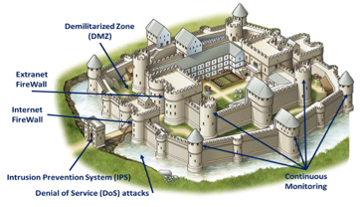
Cyber Security – Castle view

Slide 13
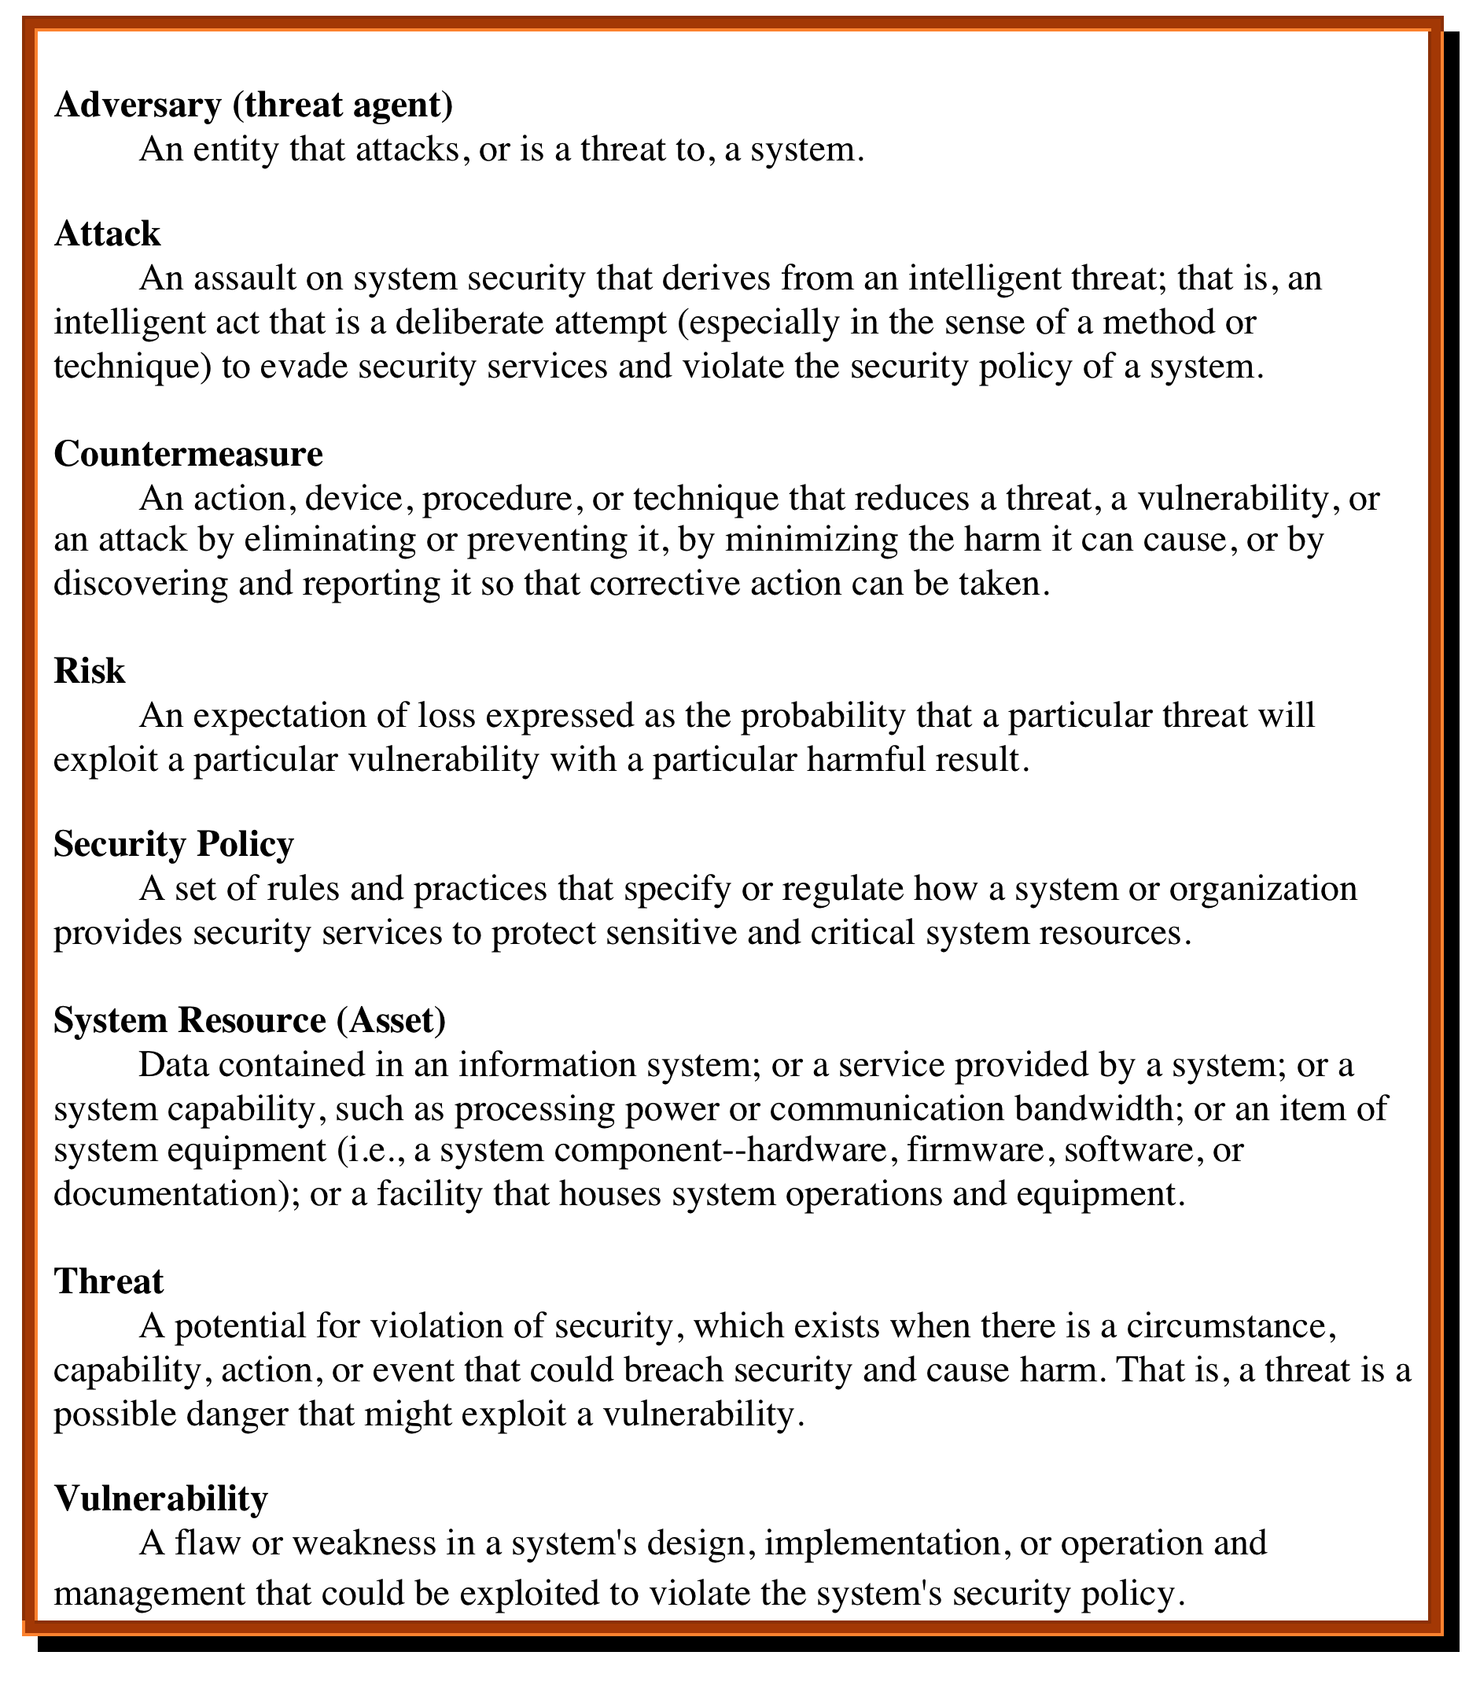
Security Terminologies
Notes:
We now introduce some terminology that will be useful throughout the book, relying
on RFC 4949, Internet Security Glossary . Table 1.1 defines terms.

Slide 14
Why are there security vulnerabilities?
Lots of buggy software...
Why do programmers write insecure code?
Awareness is the main issue
Some contributing factors
Few security audits
C is an unsafe language
Programming text books do not emphasize security
Programmers have other things to worry about
Legacy software
Consumers do not care about security
Security is expensive and takes time
A vulnerability that is “too complicated for anyone to ever find” will be found !

Slide 15
Vulnerabilities, Threats and Attacks
Categories of vulnerabilities
Corrupted (loss of integrity)
Leaky (loss of confidentiality)
Unavailable or very slow (loss of availability)
Threats
Capable of exploiting vulnerabilities
Represent potential security harm to an asset
Attacks (threats carried out)
Passive – attempt to learn or make use of information from the system that does not affect system resources
Active – attempt to alter system resources or affect their operation
Insider – initiated by an entity inside the security parameter
Outsider – initiated from outside the parameter
Notes:
In the context of security, our concern is with the vulnerabilities of system
resources. [NRC02] lists the following general categories of vulnerabilities of a
computer system or network asset:
• It can be corrupted , so that it does the wrong thing or gives wrong answers.
For example, stored data values may differ from what they should be because
they have been improperly modified.
• It can become leaky . For example, someone who should not have access to
some or all of the information available through the network obtains such
access.
• It can become unavailable or very slow. That is, using the system or network
becomes impossible or impractical.
These three general types of vulnerability correspond to the concepts of integrity,
confidentiality, and availability, enumerated earlier in this section.
Corresponding to the various types of vulnerabilities to a system resource are
threats that are capable of exploiting those vulnerabilities. A threat represents a
potential security harm to an asset. An attack is a threat that is carried out (threat
action) and, if successful, leads to an undesirable violation of security, or threat
consequence. The agent carrying out the attack is referred to as an attacker, or
threat agent . We can distinguish two types of attacks:
• Active attack: An attempt to alter system resources or affect their operation.
• Passive attack: An attempt to learn or make use of information from the
system that does not affect system resources.
We can also classify attacks based on the origin of the attack:
• Inside attack: Initiated by an entity inside the security perimeter (an “insider”).
The insider is authorized to access system resources but uses them in a way not
approved by those who granted the authorization.
• Outside attack: Initiated from outside the perimeter, by an unauthorized or
illegitimate user of the system (an “outsider”). On the Internet, potential
outside attackers range from amateur pranksters to organized criminals, international
terrorists, and hostile governments.

Slide 16
**Table is on page 20 in the textbook. “Computer Security”
Notes:
Table 1.2 , based on RFC 4949, describes four kinds of threat consequences and lists
the kinds of attacks that result in each consequence.
Unauthorized disclosure is a threat to confidentiality. The following types of
attacks can result in this threat consequence:
• Exposure: This can be deliberate, as when an insider intentionally releases
sensitive information, such as credit card numbers, to an outsider. It can also
be the result of a human, hardware, or software error, which results in an entity
gaining unauthorized knowledge of sensitive data. There have been numerous
instances of this, such as universities accidentally posting student confidential
information on the Web.
• Interception: Interception is a common attack in the context of communications.
On a shared local area network (LAN), such as a wireless LAN or a
broadcast Ethernet, any device attached to the LAN can receive a copy of
packets intended for another device. On the Internet, a determined hacker
can gain access to e-mail traffic and other data transfers. All of these situations
create the potential for unauthorized access to data.
• Inference: An example of inference is known as traffic analysis, in which an
adversary is able to gain information from observing the pattern of traffic on
a network, such as the amount of traffic between particular pairs of hosts on
the network. Another example is the inference of detailed information from
a database by a user who has only limited access; this is accomplished by
repeated queries whose combined results enable inference.
• Intrusion: An example of intrusion is an adversary gaining unauthorized
access to sensitive data by overcoming the system’s access control protections.
Deception is a threat to either system integrity or data integrity. The following
types of attacks can result in this threat consequence:
• Masquerade: One example of masquerade is an attempt by an unauthorized
user to gain access to a system by posing as an authorized user; this could
happen if the unauthorized user has learned another user’s logon ID and
password. Another example is malicious logic, such as a Trojan horse, that
appears to perform a useful or desirable function but actually gains unauthorized
access to system resources or tricks a user into executing other malicious
logic.
• Falsification: This refers to the altering or replacing of valid data or the introduction
of false data into a file or database. For example, a student may alter
his or her grades on a school database.
• Repudiation: In this case, a user either denies sending data or a user denies
receiving or possessing the data.
Disruption is a threat to availability or system integrity. The following types of
attacks can result in this threat consequence:
• Incapacitation: This is an attack on system availability. This could occur as a
result of physical destruction of or damage to system hardware. More typically,
malicious software, such as Trojan horses, viruses, or worms, could operate in
such a way as to disable a system or some of its services.
• Corruption: This is an attack on system integrity. Malicious software in this
context could operate in such a way that system resources or services function
in an unintended manner. Or a user could gain unauthorized access to a system
and modify some of its functions. An example of the latter is a user placing
backdoor logic in the system to provide subsequent access to a system and its
resources by other than the usual procedure.
Obstruction: One way to obstruct system operation is to interfere with communications
by disabling communication links or altering communication
control information. Another way is to overload the system by placing excess
burden on communication traffic or processing resources.
Usurpation is a threat to system integrity. The following types of attacks can
result in this threat consequence:
• Misappropriation: This can include theft of service. An example is a distributed
denial of service attack, when malicious software is installed on a number of hosts
to be used as platforms to launch traffic at a target host. In this case, the malicious
software makes unauthorized use of processor and operating system resources.
• Misuse: Misuse can occur by means of either malicious logic or a hacker that
has gained unauthorized access to a system. In either case, security functions
can be disabled or thwarted.

Slide 17
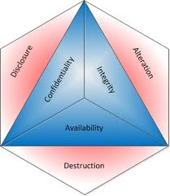
Security properties … CIA triad
Confidentiality
Information about system or its users cannot be learned by an attacker
Integrity
The system continues to operate properly, only reaching states that would occur if there were no attacker
Availability
Actions by an attacker do not prevent users from having access to use of the system

Slide 18
Aspects of Security
consider 3 aspects of information security:
security attacks
security services
security mechanisms
Notes:
The OSI security architecture focuses on security attacks,mechanisms,and services. These can be defined briefly as follows:
• Security attack: Any action that compromises the security of information owned by an organization.
• Security mechanism: A process (or a device incorporating such a process) that is designed to detect, prevent,or recover from a security attack.
• Security service: A processing or communication service that enhances the security of the data processing systems and the information transfers of an organization. The services are intended to counter security attacks, and they make use of one or more security mechanisms to provide the service.

Slide 19
Security Attack
any action that compromises the security of information owned by an organization
often threat & attack used to mean same thing
Threat: A person, thing, event, or idea which poses some danger to an asset in terms of that asset's confidentiality, integrity, availability.
Attack: A realization of a threat; Any action that attempts to compromise the security of the information owned by an organization/person

Slide 20
Attacks
Nature of attacks
Active attacks
Passive attacks
Categorization of attacks
Interruption
Interception
Modification
Fabrication

Slide 21
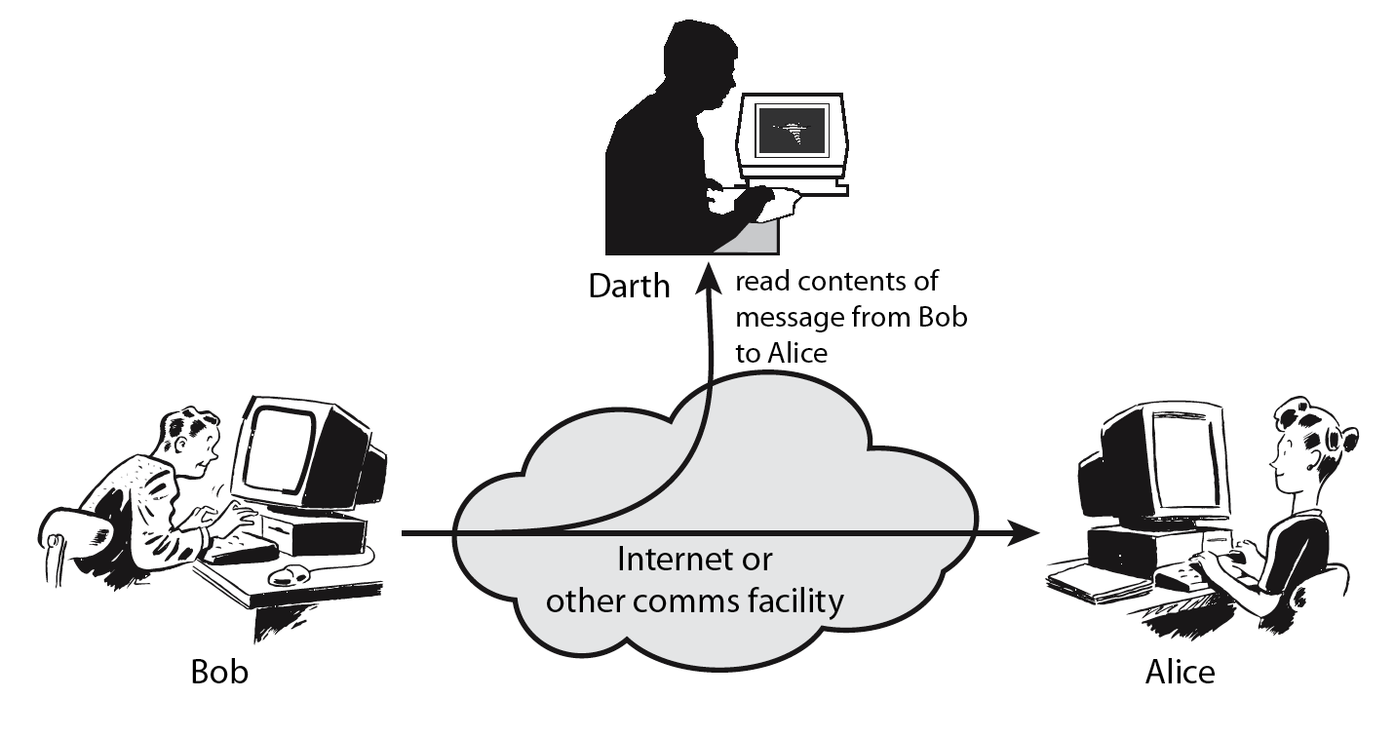
Passive Attacks
Notes:
Have “passive attacks” which attempt to learn or make use of information from the system but does not affect system resources.
By eavesdropping on, or monitoring of, transmissions to:
+ obtain message contents or
+ monitor traffic flows
Are difficult to detect because they do not involve any alteration of the data.

Slide 22
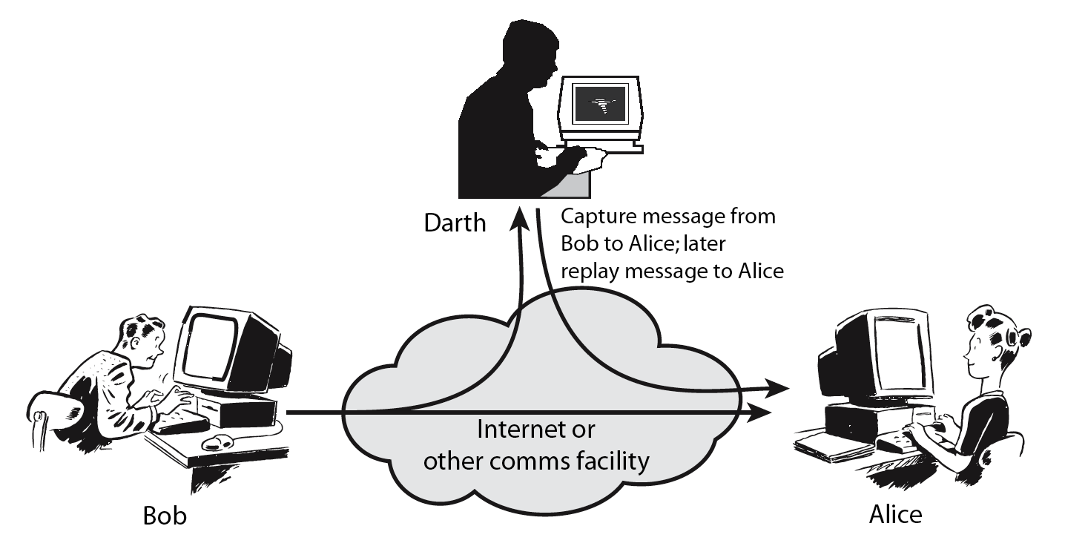
Active Attacks
Notes:
Also have “active attacks” which attempt to alter system resources or affect their operation.
By modification of data stream to:
+ masquerade of one entity as some other
+ replay previous messages
+ modify messages in transit
+ denial of service
Active attacks present the opposite characteristics of passive attacks. Whereas passive attacks are difficult to detect, measures are available to prevent their success. On the other hand, it is quite difficult to prevent active attacks absolutely, because of the wide variety of potential physical,software,and network vulnerabilities. Instead, the goal is to detect active attacks and to recover from any disruption or delays caused by them.

Slide 24
Security Service
enhance security of data processing systems and information transfers of an organization
intended to counter security attacks
using one or more security mechanisms
Notes:
Consider the role of a security service, and what may be required.
Note both similarities and differences with traditional paper documents, which for example:
have signatures & dates;
need protection from disclosure, tampering, or destruction;
may be notarized or witnessed;
may be recorded or licensed

Slide 25
Security Services (X.800)
Authentication - assurance that the communicating entity is the one claimed
Access Control - prevention of the unauthorized use of a resource
Data Confidentiality –protection of data from unauthorized disclosure
Data Integrity - assurance that data received is as sent by an authorized entity
Non-Repudiation - protection against denial by one of the parties in a communication

Slide 26
Security Mechanisms
feature designed to detect, prevent, or recover from a security attack
no single mechanism that will support all services required
however one particular element underlies many of the security mechanisms in use:
cryptographic techniques
hence our focus on this topic
Notes:
Now introduce “Security Mechanism” which are the specific means of implementing one or more security services.
Note these mechanisms span a wide range of technical components, but one aspect seen in many is the use of cryptographic techniques.

Slide 27
Security Mechanisms
specific security mechanisms:
encipherment
digital signatures
access controls
Message authentication code
traffic padding
routing control

Slide 28
Data Privacy in communication … Services & Mechanisms
Confidentiality: Unauthorized parties cannot access information (->Secret Key Encryption)
Authenticity: Ensuring that the actual sender is the claimed sender. (->Public Key Encryption)
Integrity: Ensuring that the message was not modified in transmission. (->Hashing)
Nonrepudiation: Ensuring that sender cannot deny sending a message at a later time. (->Digital Signature)
Bill
Confidentiality
Joe
Bill
Authenticity
Joe (Actually Bill)
Ann
Ann
Integrity
Joe
Non-Repudiation
Joe
Bill
Ann
Ann
Notes:
The tools in parenthesis provide the features specified.

Slide 29
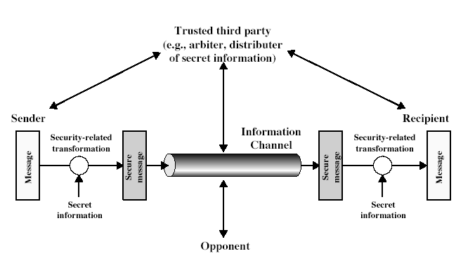
Model for Security

Slide 30
Model for Security
using this model requires us to:
design a suitable algorithm for the security transformation
generate the secret information (keys) used by the algorithm
develop methods to distribute and share the secret information
specify a protocol enabling the principals to use the transformation and secret information for a security service

Slide 31
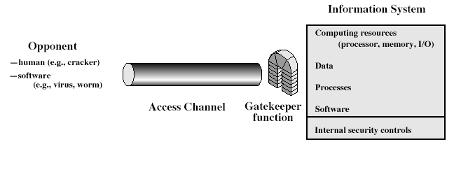
Model for Network Access Security

Slide 32
Model for Network Access Security
using this model requires us to:
select appropriate gatekeeper functions to identify users
implement security controls to ensure only authorised users access designated information or resources
trusted computer systems may be useful to help implement this model

Slide 33
Summary
have considered:
Basic definitions
computer, network, internet security
security attacks, services, mechanisms
models for network (access) security
Notes:
Chapter 1 summary.

Slide 35
Statistics
According the certain estimates by McAfee & Kapersky Lab, the cost of information security breaches that took place in 2018 was worth $600 billion.
Globally, information security breaches have witnessed a steep increase of 67% in the last five years
In last quarter of 2018, a single incident of cyberattack on Private Bank operating in Pakistan resulted in the loss of $6 million in just 23 minutes

Slide 36
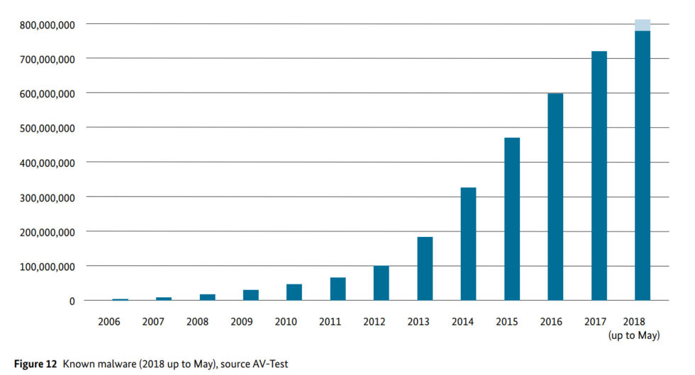
Malware Count

Slide 37
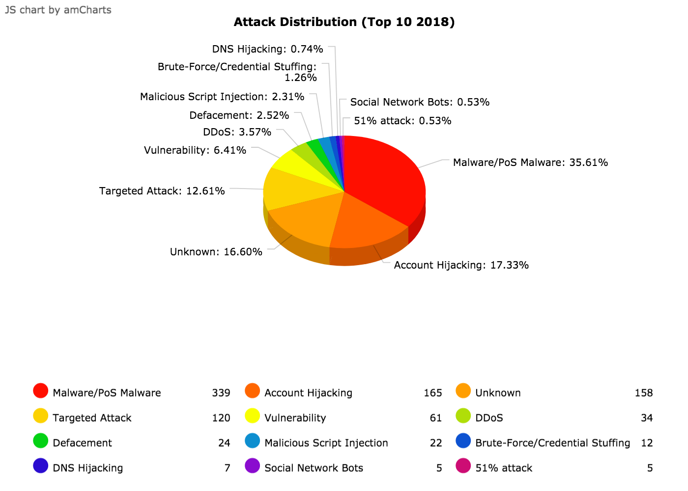
https://www.hackmageddon.com/

Slide 38
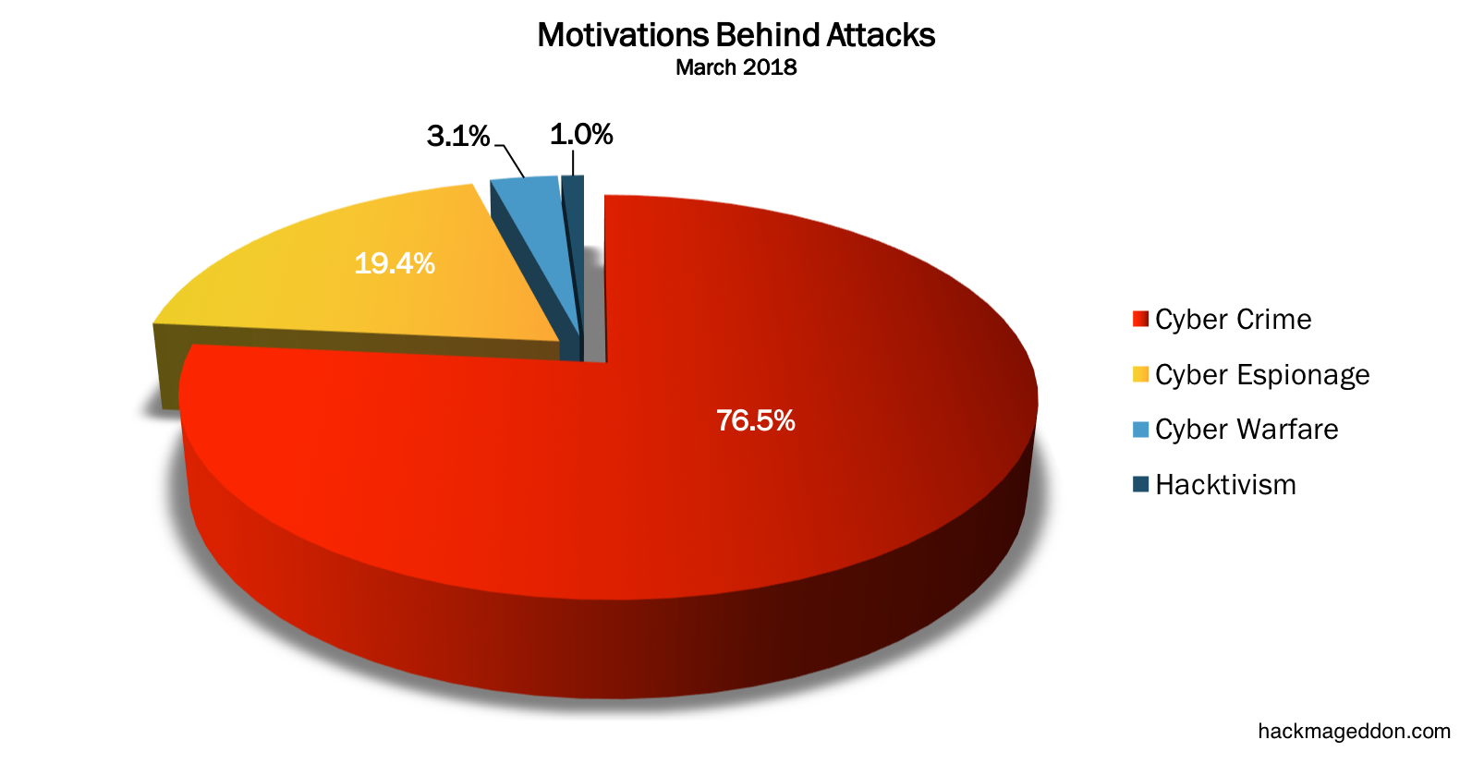
https://www.hackmageddon.com/

Slide 39
Why do we need security?
Lets go through some real-world examples.

Slide 40
Mirai Botnet – Case Study
First identified in August 2016 by the whitehat security research group MalwareMustDie, Mirai—Japanese for “the future”—and its many variants have served as the vehicle for some of the most potent DDoS attacks in history.
In September 2016, the website of computer security consultant Brian Krebs was hit with 620 gbps of traffic, “many orders of magnitude more traffic than is typically needed to knock most sites offline.”2 At about the same time, an even bigger DDoS attack using Mirai malware—peaking at 1.1 Tbps— targeted the French webhost and cloud service provider OVH
https://www.rsaconference.com/writable/presentations/file_upload/hta-w10-mirai-and-iot-botnet-analysis.pdf
https://www.imperva.com/blog/malware-analysis-mirai-ddos-botnet/?utm_campaign=Incapsula-moved
https://www.csoonline.com/article/3258748/the-mirai-botnet-explained-how-teen-scammers-and-cctv-cameras-almost-brought-down-the-internet.html

Slide 41
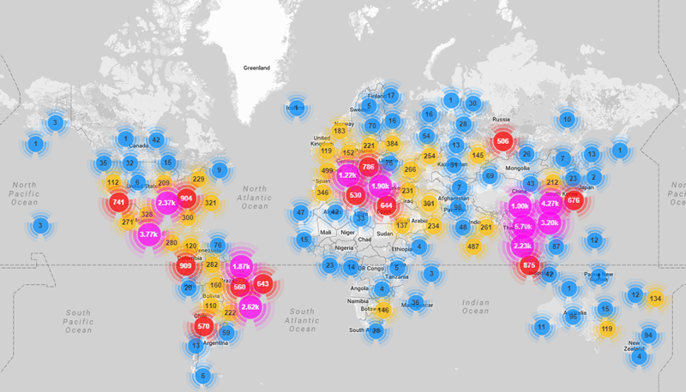
Mirai - Bots
https://www.imperva.com/blog/malware-analysis-mirai-ddos-botnet/?utm_campaign=Incapsula-moved

Slide 42
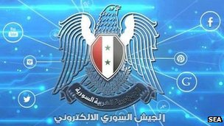
New York Times and Twitter struggle after Syrian hack … (2013)
The newspaper and social network were hit after their domain name details were maliciously edited by hackers.
The Syrian Electronic Army (SEA), a group supporting Syrian president Bashar al-Assad, says it carried out the attack.
In recent months, these hackers have targeted major media companies including the Financial Times, Washington Post, CNN and BBC.
The SEA was able to gain access to Melbourne IT's system, where Twitter and the New York Times registered their respective domains.
http://www.bbc.co.uk/news/technology-23862105

Slide 43
Major banks hit with biggest cyber attacks in history… (2012)
The websites of Bank of America, JPMorgan, U.S. Bank and PNC Bank all suffered day-long slowdowns and been sporadically unreachable for many customers ….
A denial of service attack
The attackers got hold of thousands of high-powered application servers and pointed them all at the targeted banks.
The volume of traffic sent to these sites was 10 to 20 times the volume that was normally recorded.
http://money.cnn.com/2012/09/27/technology/bank-cyberattacks/index.html
By David Goldman CNN September 28, 2012

Slide 44
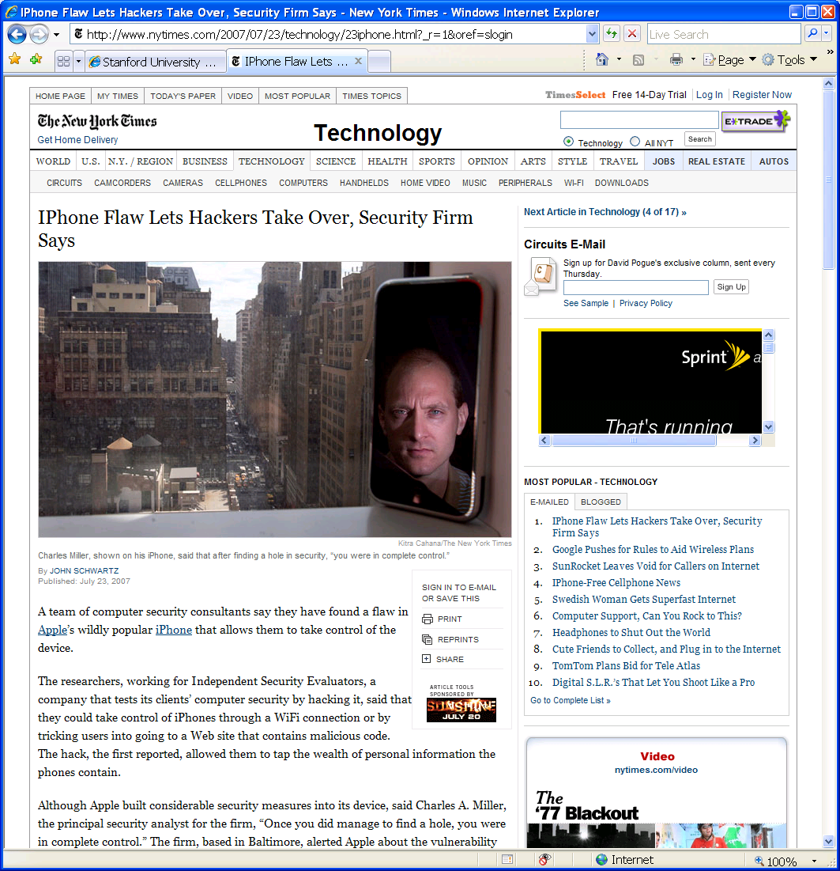
iPhone attack … (2007)
iPhone Safari downloads malicious web page
Arbitrary code is run with administrative privileges
Can read SMS log, address book, call history, other data
could dial phone numbers, send text messages, or record audio
Transmit collected data over network to attacker
http://www.securityevaluators.com/iphone/

Slide 45
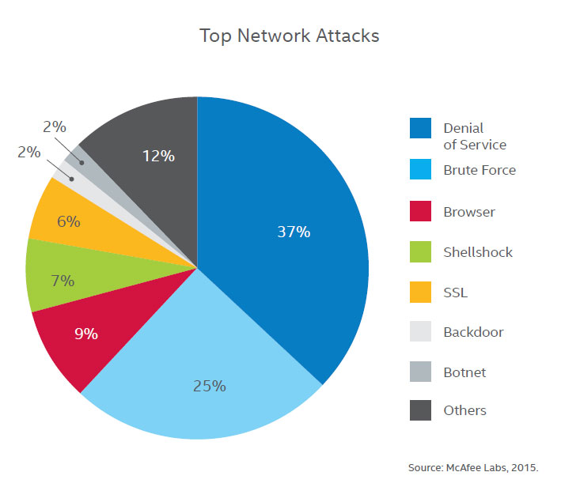
Top 7 Network Attacks of 2015 … so far June 2015
http://www.calyptix.com/top-threats/top-7-network-attack-types-in-2015-so-far/

Slide 46
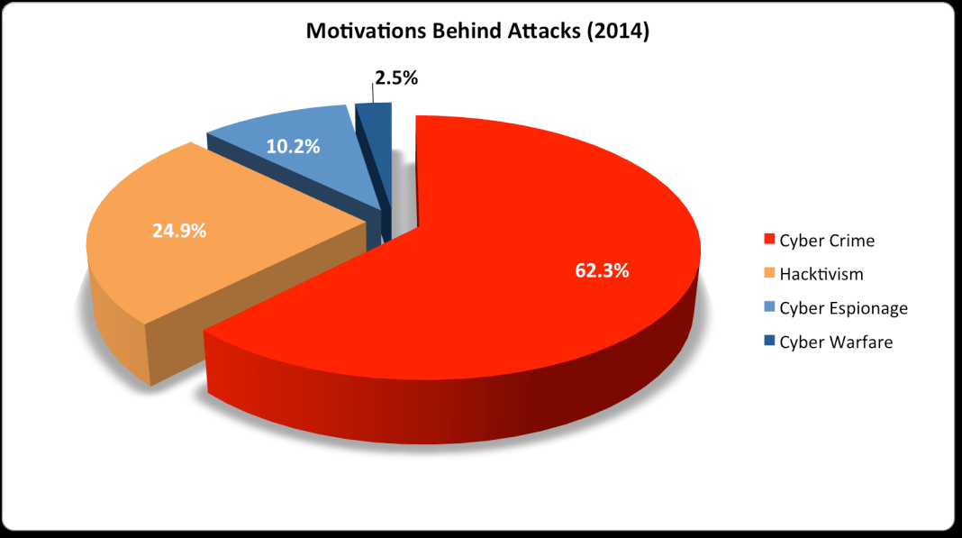

Slide 47
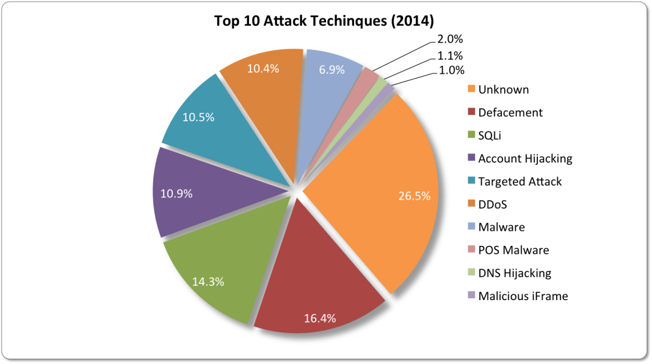
Top 10 network attacks techniques of 2014
Notes:
Website defacement is an attack on a website that changes the visual appearance of the site or a webpage. These are typically the work of system crackers, who break into a web server and replace the hosted website with one of their own.
Point-of-sale malware (POS malware) is malicious software expressly written to steal customer payment data -- especially credit card data -- from retail checkout

Slide 48
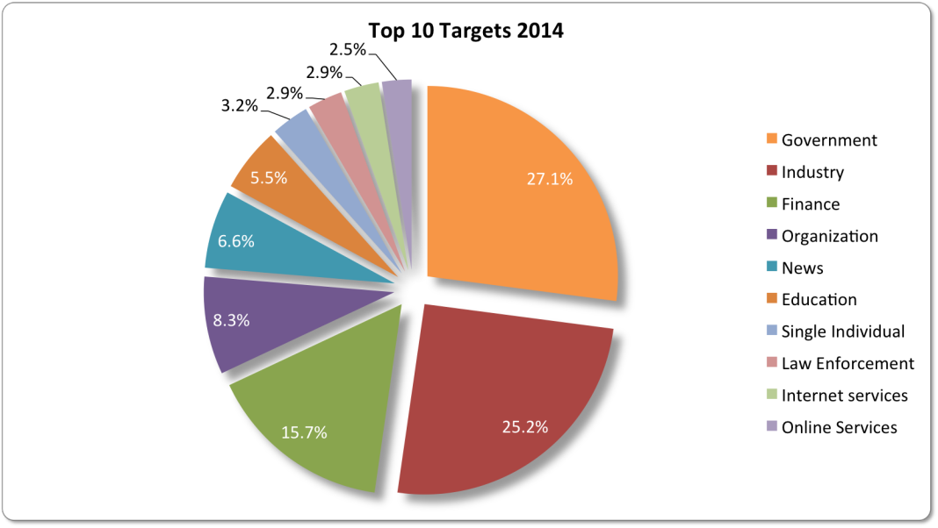

Slide 49
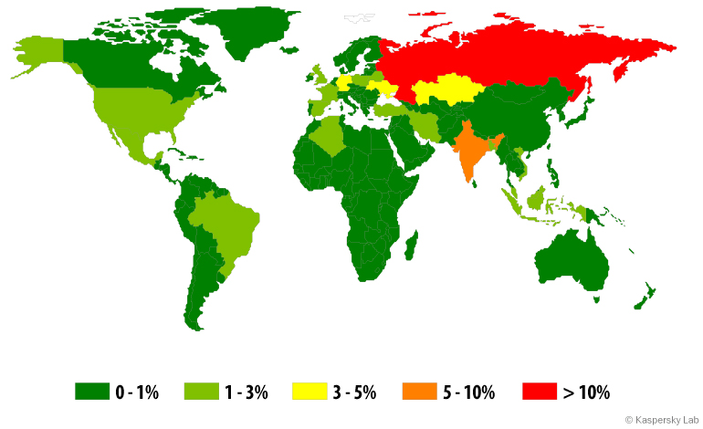
Mobile threats 2014

Slide 50
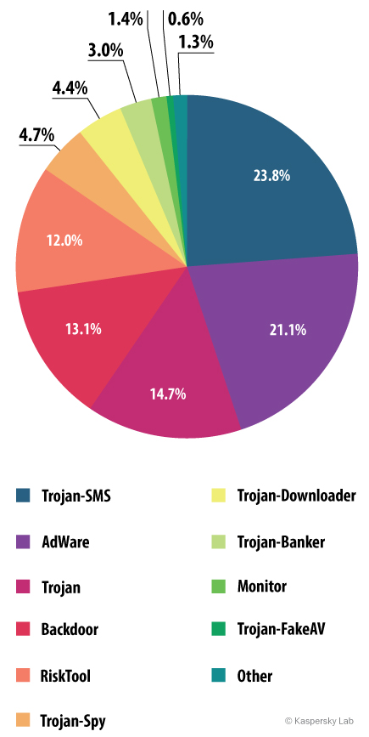
Mobile threats 2014

Slide 51
Top 5 out of 20 Mobile threats of 2014
1 | Trojan-SMS.AndroidOS.Stealer.a | 18.0%
2 | RiskTool.AndroidOS.MimobSMS.a | 7.1%
3 | DangerousObject.Multi.Generic | 6.9%
4 | RiskTool.AndroidOS.SMSreg.gc | 6.7%
5 | Trojan-SMS.AndroidOS.OpFake.bo | 6.4%

Slide 52
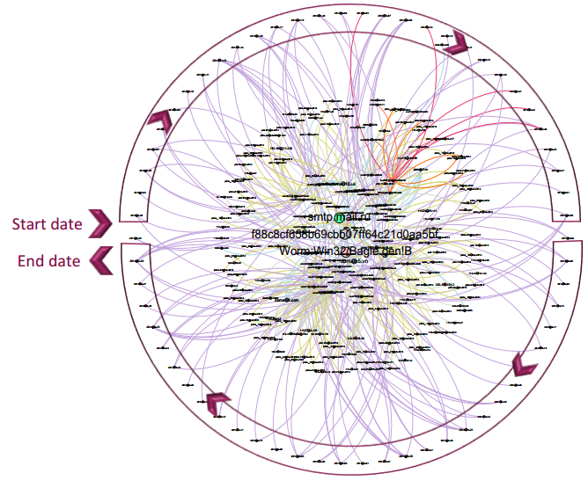
Mass-scale Organizational Targeted Attacks (MOTAs)
Bagle mass-mailer worm campaign between January 1, 2014, and April 29, 2014
Source: Symantec April 2015
Notes:
targeted no less than 12 companies located in Europe, Asia, and Australia; and was active in seven different industry sectors, including public administration, finance
and insurance, and transportation. A total of 155 emails were sent over a period of about four months. This campaign thus appears loosely focused.
When looking at the file attached to the emails, we can see that all emails were carrying a variant of the Bagle worm (Worm:Win32/Bagle.gen!B), which is a piece of code that replicates itself automatically by sending copies of itself via an attached file in an email.
Although the attached file name (pattern: “[8-12 characters].exe”) was different in almost every spear phishing email, the content of the file was identical throughout the campaign (md5=f88c8cf658b69cbb07ff64c-21d0aa5bf). Moreover, the subject line included in the emails varied with the attachment file name and always followed the pattern “price[ -_][date in the format dd-mm-yyyy].” Also, we found that the instance of the Bagle worm observed in this campaign used the free Russian mail
service mail.ru to send the emails through which it replicated itself.
Symantec customers were protected against these attacks.

Slide 53
Recent Trends
Malware, worms, and Trojan horses
spread by email, instant messaging, malicious or infected websites
Botnets and zombies
improving their encryption capabilities, more difficult to detect
Scareware – fake/rogue security software
Attacks on client-side software
browsers, media players, PDF readers, etc.
Ransom attacks
malware encrypts hard drives, or DDOS attack
Social network attacks
Users’ trust in online friends makes these networks a prime target.
Texas CISO, Feb 2010

Slide 54
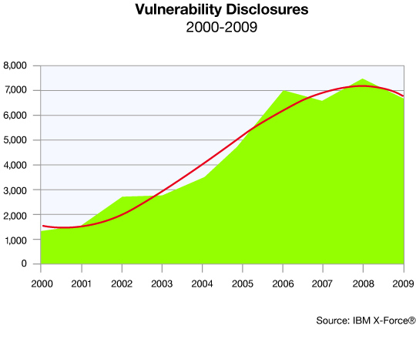
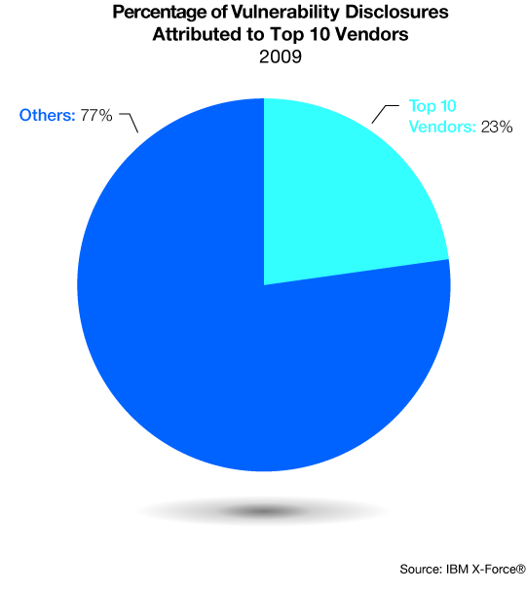
Trends

Slide 55
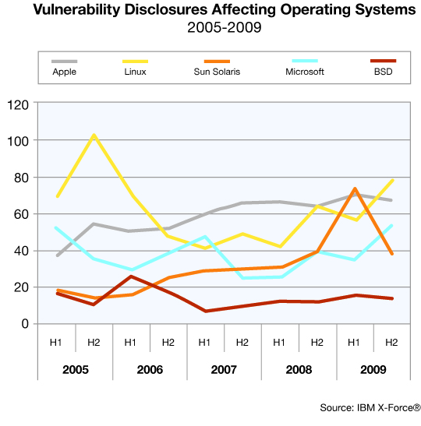
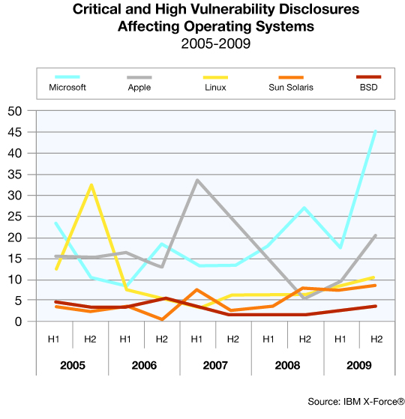
Operating system vulnerabilities

Slide 56
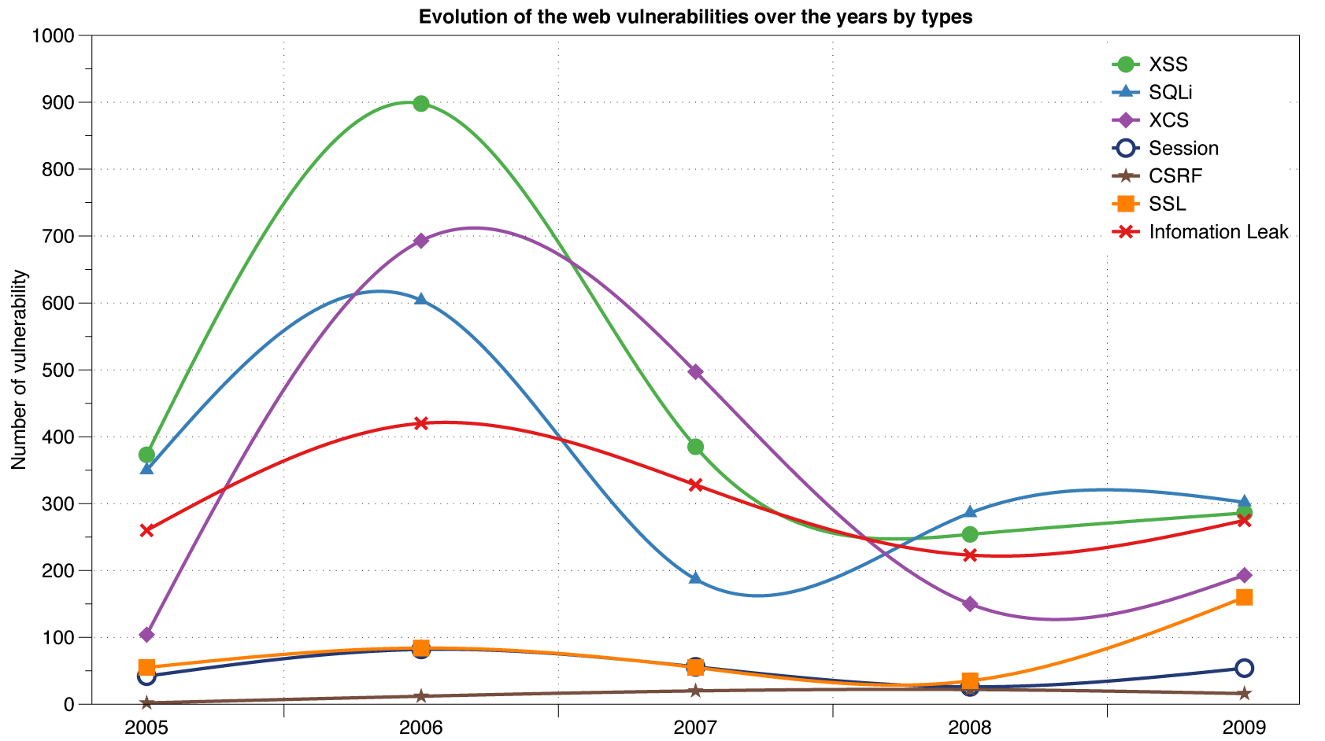
Reported Web Vulnerabilities "In the Wild"
Cross-site scripting (XSS)
Data from aggregator and validator of NVD-reported vulnerabilities
Notes:
Cross-site scripting (XSS) is a type of computer security vulnerability typically found in Web applications. XSS enables attackers to inject client-side script into Web pages viewed by other users. A cross-site scripting vulnerability may be used by attackers to bypass access controls such as the same origin policy. Cross-site scripting carried out on websites accounted for roughly 84% of all security vulnerabilities documented by Symantec as of 2007.[

Slide 57
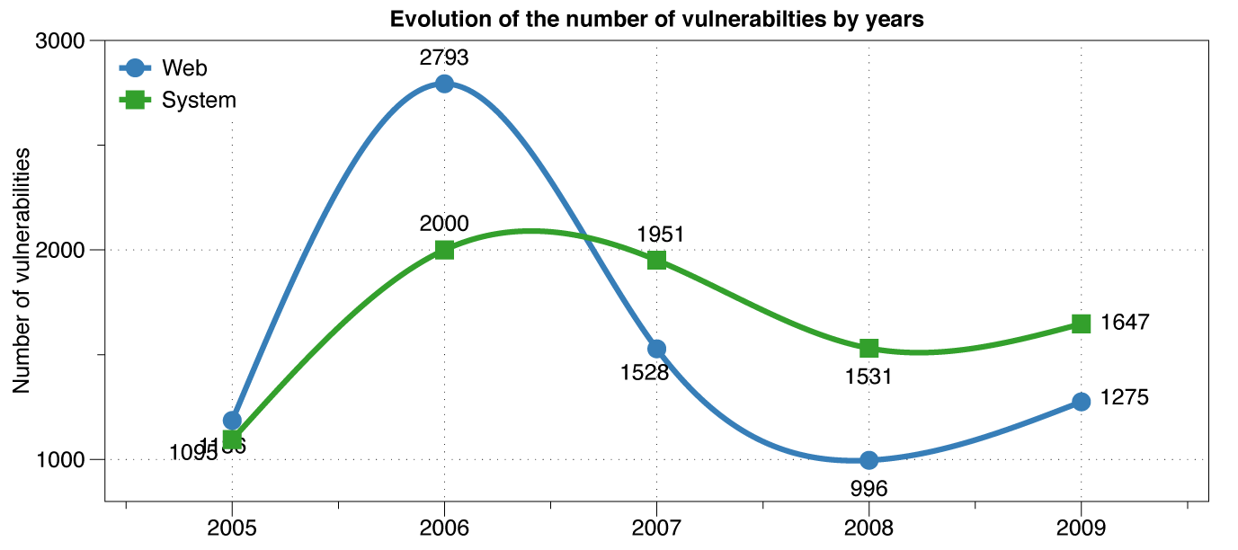
Web vs System vulnerabilities

Slide 58
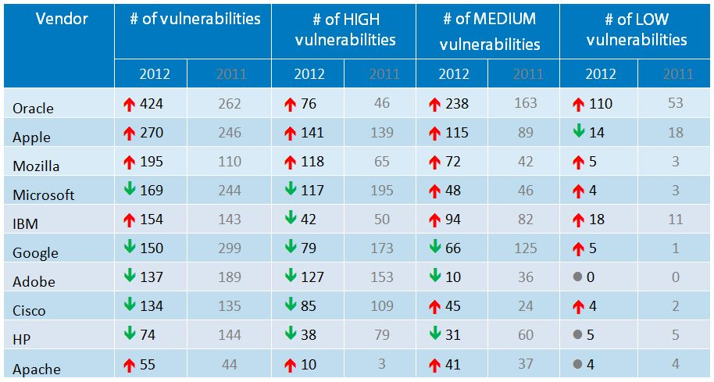
http://www.gfi.com/blog/report-the-most-vulnerable-operating-systems-and-applications-in-2012/

